Slide 1
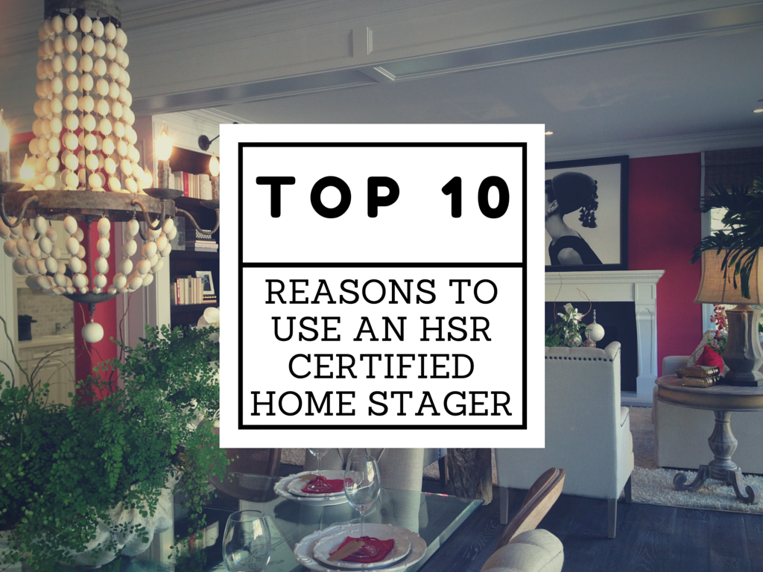
Notes:
Not all stagers are equal and going through an intensive, RESA Accredited certification course for home staging and redesign was critical to developing my skillsets. The HSR Certification is also an ongoing learning program, so I’m constantly on top of staging, design and real estate trends, as well as have access to a wealth of marketing materials to help my agent partners look great. This is just one example of the kinds of materials HSR provides to it’s certified members…

Slide 2
Notes:
In a 2015 survey of over 3,500 homes professionally staged, over 50% sold for 10% MORE than their unstaged neighbors home!

Slide 3
Notes:
When the seller spent an average of 1% of the value of their home on staging, they saw on average a 1000% return on investment!

Slide 4
Notes:
In a recent Real Estate Staging Association Survey, professionally staged homes spent 72% LESS time on the market!

Slide 5
Notes:
In a 2015 National Association of Realtor Survey, over 81% of Buyers said it was easier to visualize the STAGED property as their next home!

Slide 6
Notes:
According to the National Association of Realtors (NAR), over 95% of buyers are online FIRST looking at photos of the home BEFORE they go visit or call an agent! Make sure those photos are memorable and impactful!

Slide 7
Notes:
If you can't view objectively, you can't package effectively and it's nearly impossible for a seller to be objective about their home! Asking a seller to be objective about the “look” of their home is like asking a parent to be objective about the “look” of their children!

Slide 8
Notes:
According to NAR, almost a third of buyers will "overlook property faults when a home is professionally staged"!

Slide 9
Notes:
You will have the satisfaction of knowing you have done everything possible to get the absolute best price for your home and not leave money on the table!

Slide 10
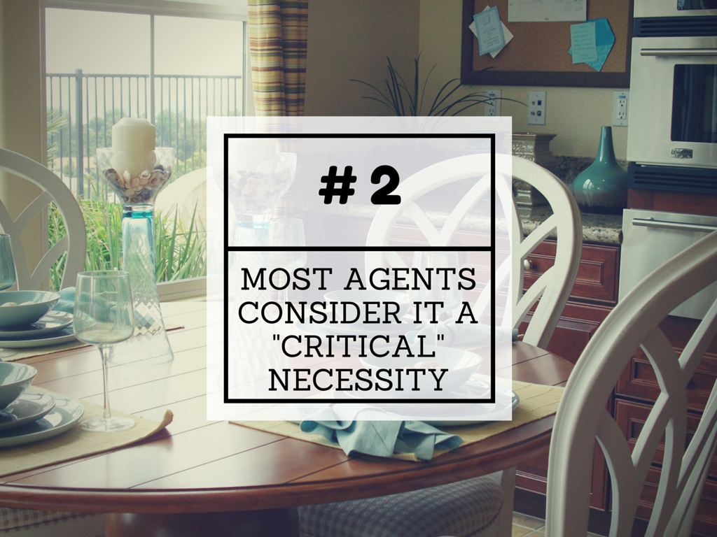
Notes:
According to a 2014 Zillow survey of real estate experts, professional home staging was listed as a TOP TWO necessary item for sellers to do before putting their home on the market!

Slide 11
Notes:
It’s okay…you don’t have to bother staging your home but just plan on getting A LOT less money (tens of thousands) and helping to sell your neighbor’s house first. Competition can be stiff and buyers have very high expectations! Successful agents know that the key to competing is professional staging because it creates great online presentations, drives buyer traffic to the home, and brings in offers.

Slide 12
Find an HSR Certified Stager
www.HomeStagingResource.com

