Slide 1

Company Name
How we work and what sets us apart

Slide 2
Who Is Our Buyer Demographic?
Price point of the homes, as well as great school district dictate a typical third home buyer, married couple with two kids ages (10-15) and family dog
Telecommuting location dictates an office in the downstairs open space
Popular “interests” for families with kids in the 10-14 age in this neighborhood are baseball, soccer, beach/surfing, horses (due to close rural/riding area)
This is a family who vacations and entertains a lot

Slide 3
The Way We Work…
Classic Finishes
Trending and Dramatic Fixtures
Classic Large Furnishings
Trending and Custom Small Furnishings
Wow-Factor, Memorable Piece Per Space

Slide 4
What is Your Luxury Level?

Slide 5
Transparency in Pricing
Budget based on client luxury level and square footage
Designer is required to stay within budget and luxury level
Designer is not incentivized to spend on high-end furnishings
Designer is required to work in a timely manner to stay on budget
Builder gets best value and design based on their luxury specifications
Design Expectation
Is Established
Budget is
Precise
Budget is
Not Padded
Speed and Efficiency are Rewarded Not Discouraged

Slide 6
Full Service Model Home Design
Based on Luxury Level of Client $25-75. per sq. ft.
Fee includes presentation, specifications and design for flooring, paint colors, counter and cabinet finishes, lighting fixtures, wall treatments, window treatments and space planning.
Fee includes the cost of all furniture, merchandising accessories, artwork, greenery, custom bedding, pillows and upholstery.
Designer hires the movers, merchandisers and custom upholsterers
Builder is responsible for purchasing sourced/specified fixtures (flooring, cabinets, lighting, plumbing and custom window treatments).
Builder is responsible for paying subcontractors directly for all paint, window covering install and finish work (tile, wood, floors, cabinets, moldings, etc…)
Builder will own all furnishings/fixtures and is encouraged to sell it in the final sale of the house at the cost they paid.

Slide 7
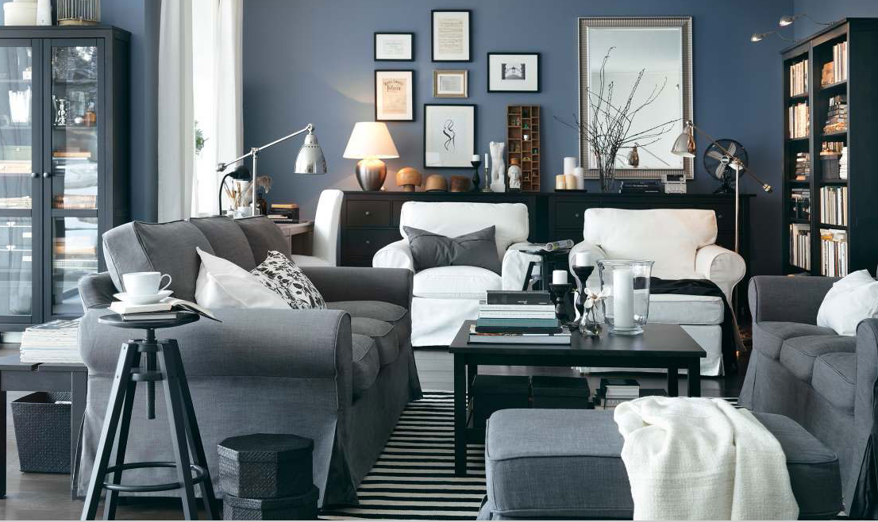
IKEA - $25 per square foot (psf)

Slide 8
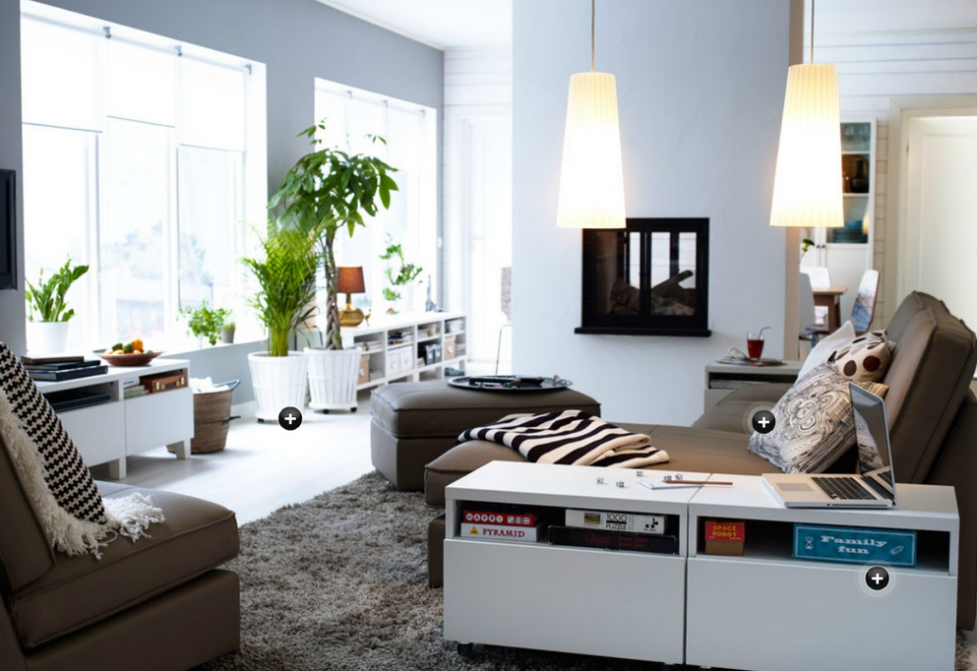
IKEA

Slide 9
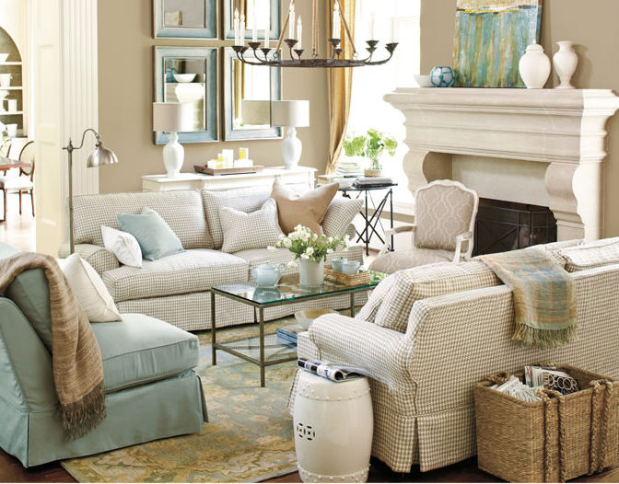
Pottery Barn/Ballard Design – $35-45 psf

Slide 10
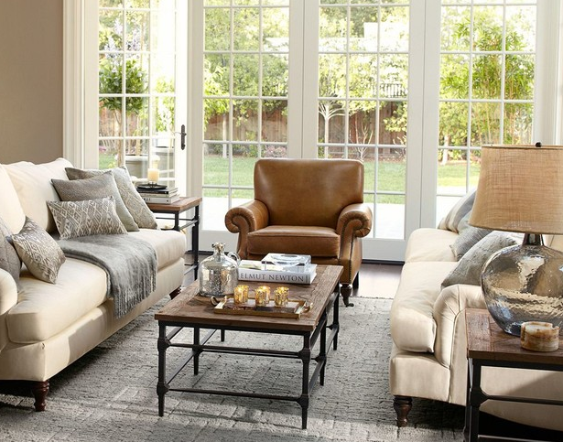
Pottery Barn/Ballard Design

Slide 11
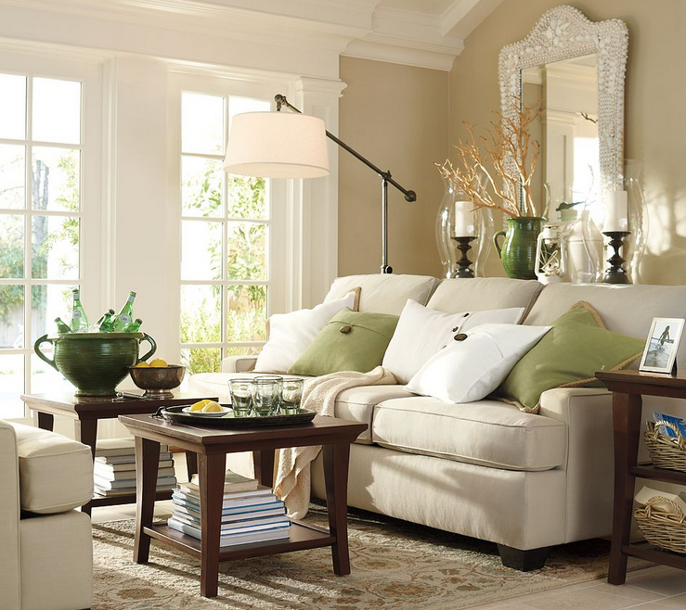
Pottery Barn/Ballard Design

Slide 12
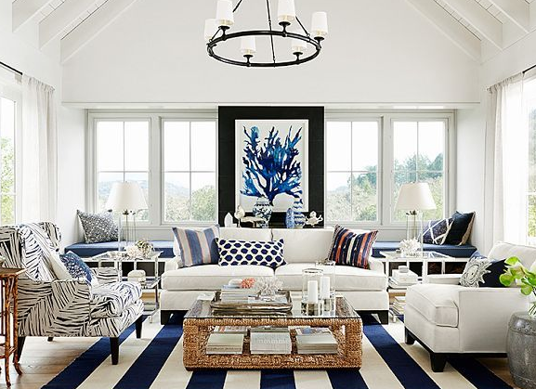
Williams Sonoma/Trade - $55-65 psf

Slide 13
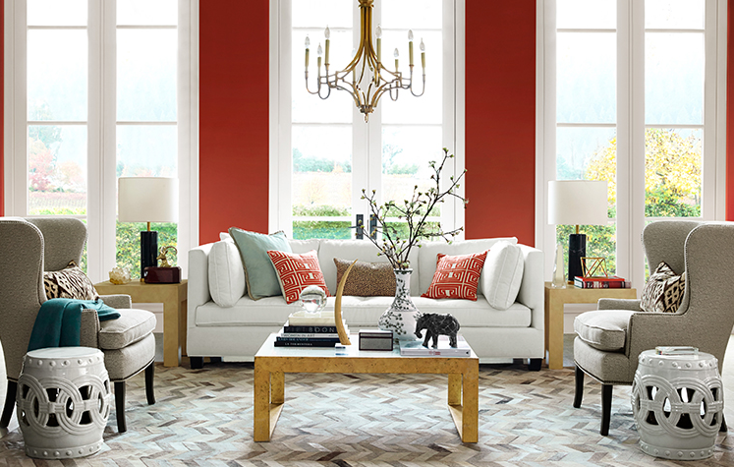
Williams Sonoma/Trade

Slide 14
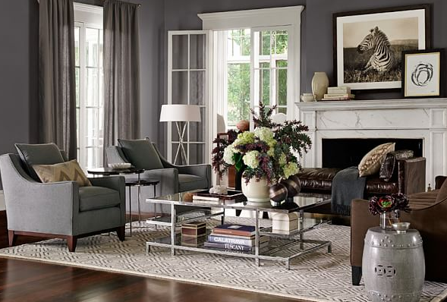
Williams Sonoma/Trade

Slide 15
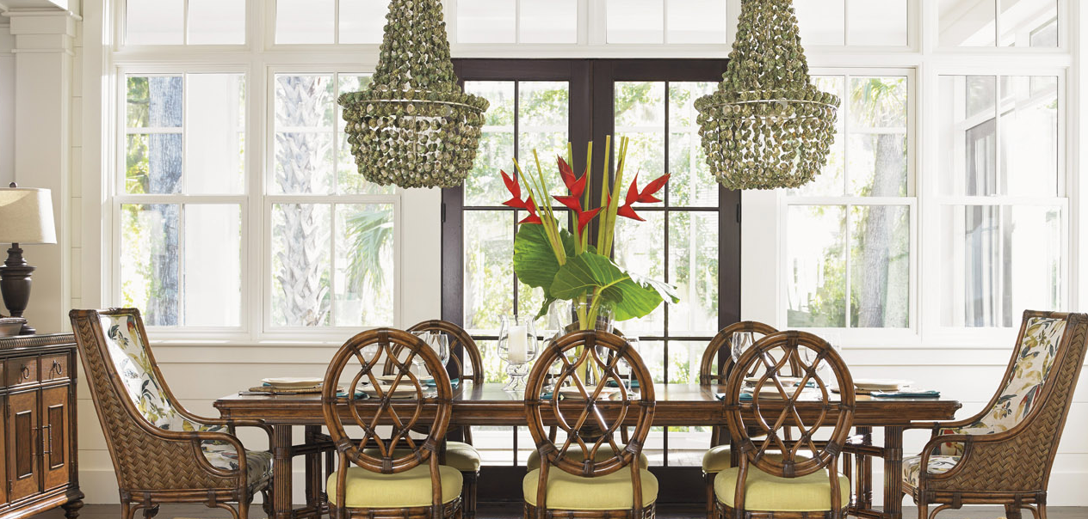
Trade and Bespoke - $75+

Slide 16
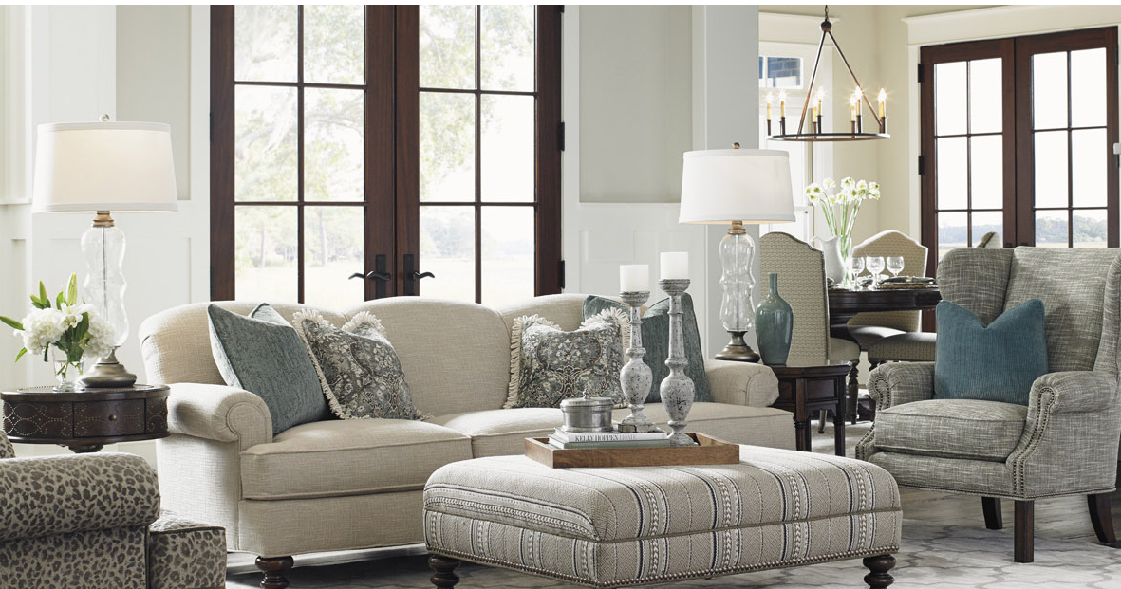
Trade and Bespoke

Slide 17
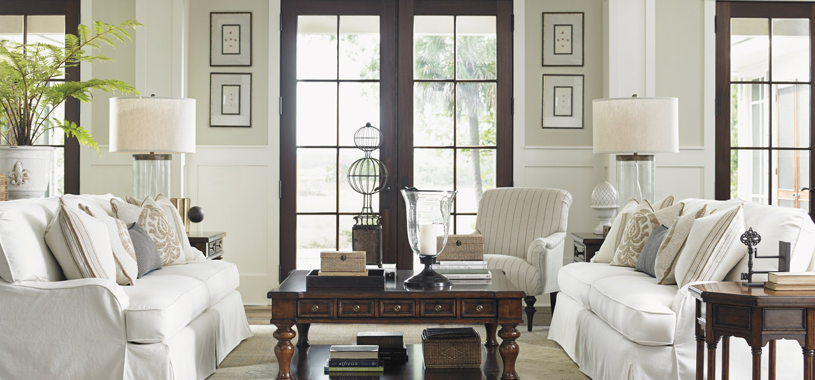
Trade and Bespoke

Slide 18
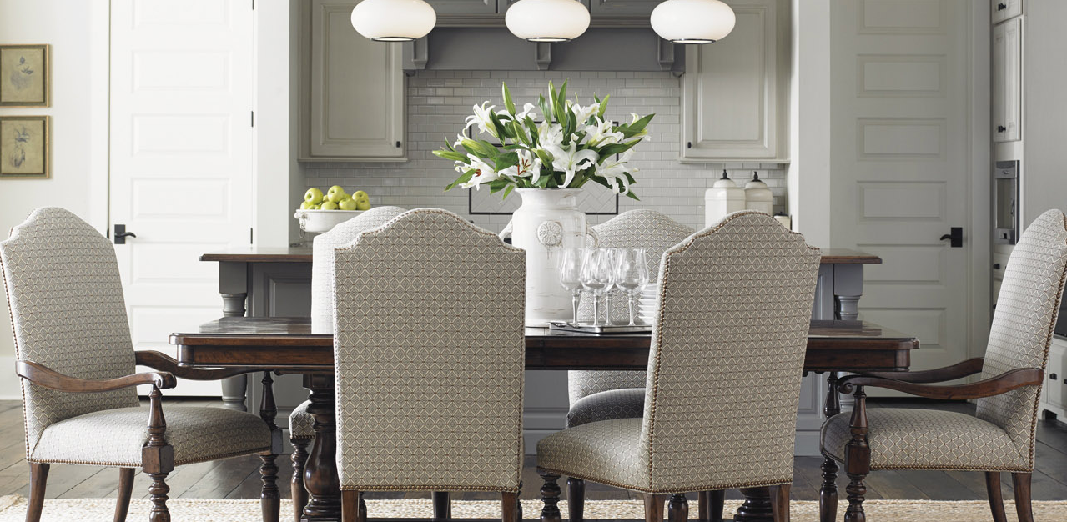
Trade and Bespoke

