Slide 1
STAGING SERVICES PROPOSAL
Date: 10-25-2019
Prepared For: Client Name/Contact Info
Property Address: 123 Olive Street
Tentative Staging Dates: Nov. 7-11, 2019
Thanks so much for the opportunity to stage your property. Please don’t hesitate to contact us with any questions or concerns. In order to move forward with our services we require a signed staging agreement which will secure the date for staging your property.
Main Areas to be Transformed:
Entry
Front Living Area
Dining Room
Kitchen
Kitchen Nook
Main Bathroom
Master Bedroom
Master Bathroom
2 Bedrooms
Staging Investment based on the luxury level , scale and size of the home is $XXX.XX:
$XXXX.00 is the total investment for staging design, installation and the initial 30 days rent, as well as removal of furnishings. Payment is due at the signing of the Staging Agreement.
A monthly renewal rate of $XXX.00 will be auto-billed to the card on file and will continue until you terminate the Staging Agreement
Staging Service Includes:
Staging Design
Selecting Furnishings
Packing and Loading
Furnishings Delivery
Staging Installation
Includes furniture, artwork and accessories
De-Staging and Inventory Pick-Up
We are expert designers who choose furnishings that compliment the home, as well as appeal to the lifestyle of the buyer who will most likely be interested in the property.
Other Pertinent Details/Client Requests Place Below:
Each home is different and has unique staging needs, so stager reserves the right to add/remove pieces above to creatively market the space for maximum staging impact. Proposal price is good for 30 days.
Home Must Be “Stage Ready” Upon Arrival or a Fee Will Be Assessed and the Appointment Rescheduled
**Stage Ready includes completion of construction, painting, repair or remodeling work, and the house must be professionally cleaned (including all surfaces, carpeting and windows professionally cleaned) and removal of unnecessary items prior to the agreed upon staging date.
**It is the responsibility of the Customer to have electricity, working heat/air and running water available
**For safety and efficiency, no one can be at property during staging without approval. Pets cannot be present without approval.
www.yourwebsite.com | 888.563.9271 | name@email.com

Slide 2
ABOUT US…
Audra Slinkey is President and Founder of the Home Staging Resource (http://www.homestagingresource.com), an advanced home staging and redesign certification training company. Audra has been awarded the Most Innovative Product of the Year Award three times for her training and serves on the board of the Real Estate Staging Association. Audra is a published author and international speaker on staging, color and design. She is proud and privileged to help create and mentor thousands of staging and design businesses across the globe.
Top Tips for Choosing the Right Home Stager for Your Project
Make Sure to Review the Home Stager’s Portfolio (Style) – Every home stager designs differently, so don’t assume we are all equal and have the same aesthetic. Have a clear idea of their talent by reviewing their portfolio and style ahead of time (I’ve included my work in this proposal below).
Ask to See Examples of Their Inventory in a Space - Each home stager shops differently and we can all agree that Walmart furniture is not the caliber of Restoration Hardware furnishings. Make sure to review the stager’s portfolio, so you are happy with their inventory and quality of furnishings.
Ask the Home Stager What Kind of “Look” You Can Expect in the Home – A qualified stager should be able to talk you through their ideas, expertise and style planning for the space.
Make Sure the Staging Matches the “Luxury Level” of the Home – Every home is unique, so it’s critical to match the furnishings with the level of luxury the buyer demographic expects in the home.
Make Sure the Scale Matches the Size of the Room and Home – The scale of furnishings in a space matter and should fill the space appropriately. Small scale living room furniture in a large, grand space will look like doll’s furniture:-). Conversely, a king bed in a smaller sized bedroom will cramp the room.
Make Sure the “Style” Matches the Style of the Home – Architectural style matters and buyers have an expectation of what they want to see inside the home many times by looking at the outside of the home.
On-Trend, Statement Pieces are Not Cheap…BUT That’s What Buyers Need to See – Luxury begets luxury and buyers are looking to “aspire to live in that home” so stagers need to have statement items, well placed in the home in order for the buyer to fall in love.
You Usually Get What You Pay For in a Vacant Home – Home Stagers have to charge enough to cover the cost of their inventory, so technically you are always getting what you pay for when it comes to the furnishings that go into a space. Unfortunately, many times stagers simply cut out inventory in order to fit your budget…this does not make for a very nicely staged home. Beware of the “lowball stager” who charges less and only puts $500 of inventory in a room vs. the stager who completely stages the space with $2500 worth of inventory…there is a difference.
Education and Reputation Matter – The staging industry is not much different than the real estate industry, so check a stager’s credentials, proof of insurance and website testimonials. I’m dedicated to enhancing your reputation with the quality of staging and design we put into your listing. I know that when you look good…I look good, so I’m excited about this potential partnership!
www.yourwebsite.com | 888.563.9271 | name@email.com

Slide 3
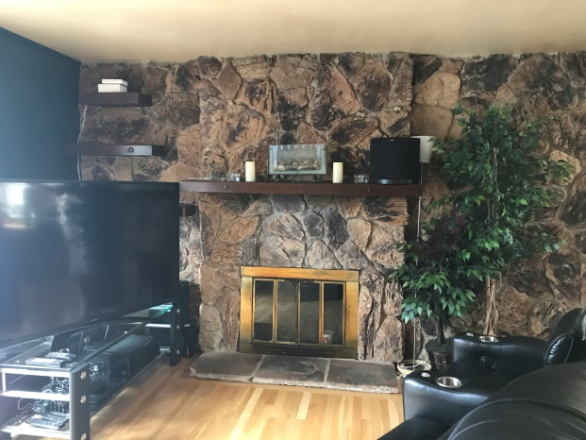
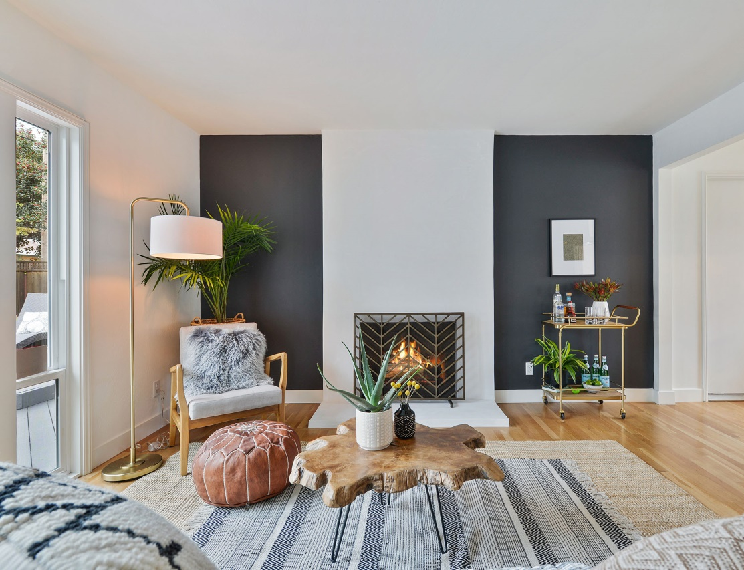
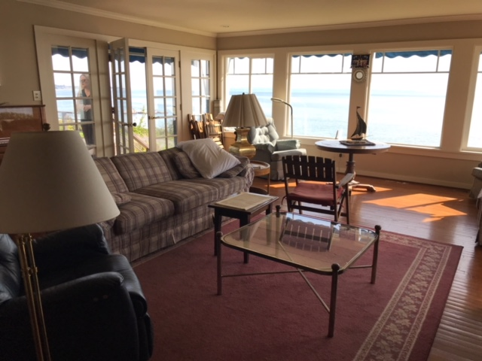
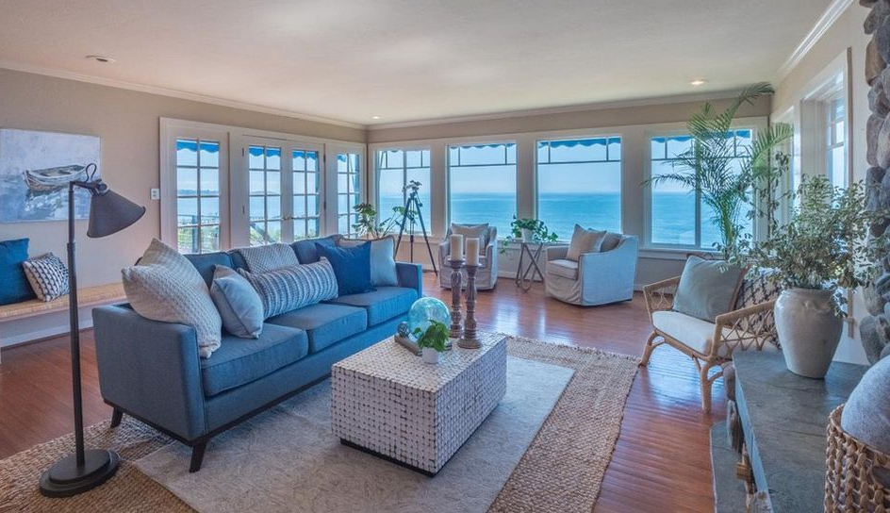
PORTFOLIO OF VACANT STAGING WORK
www.yourwebsite.com | 888.563.9271 | name@email.com

